Slide 1
Introduction to Risk Assessment

Slide 2
Learning Objectives
What is risk assessment?
Qualitative vs. Quantitative Risk Assessment
Risk assessment inputs, assumptions and outputs
Occupational vs. Community Health Risk Assessments
Practical application of risk assessments in Occupational Health

Slide 3
Risk Assessment
“a systematic process of evaluating the potential risks that may be involved in a projected activity or undertaking.”
Likelihood*Severity = Risk

Slide 4
Risk Analysis
Four disciplines:
  Risk Perception
  Risk Assessment
  Risk Communication
  Risk Management

Slide 5
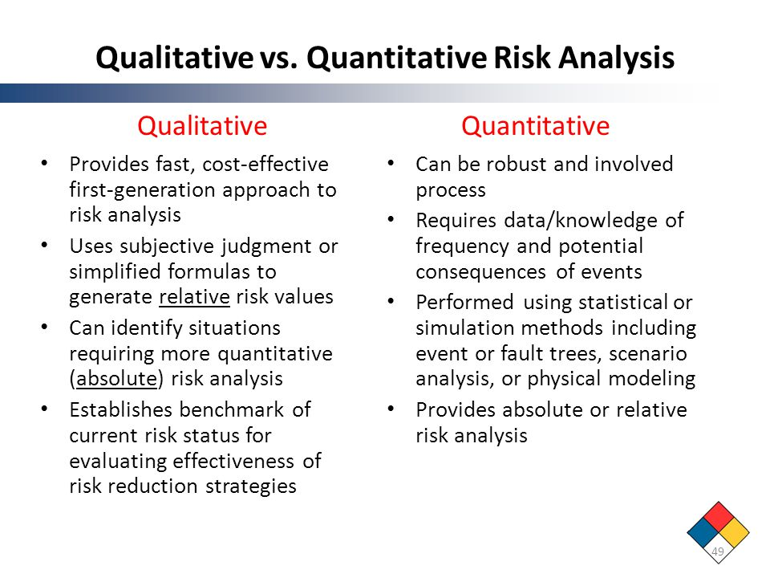
Risk Assessment
Qualitative
  High, Medium, Low
Quantitative
  Cases/100,000/yr

Slide 6
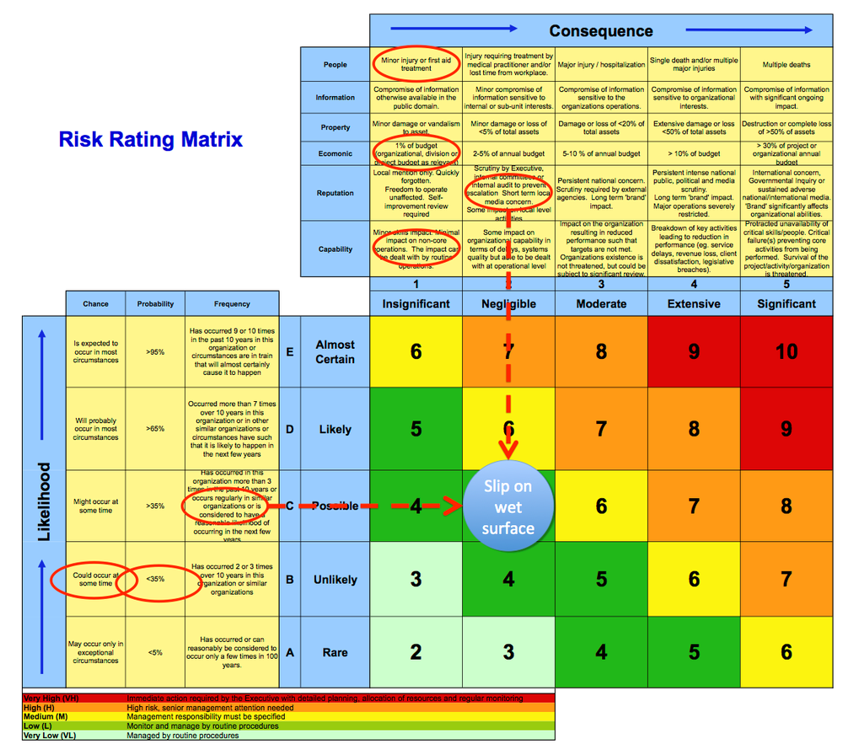
Qualitative Risk Matrix

Slide 7
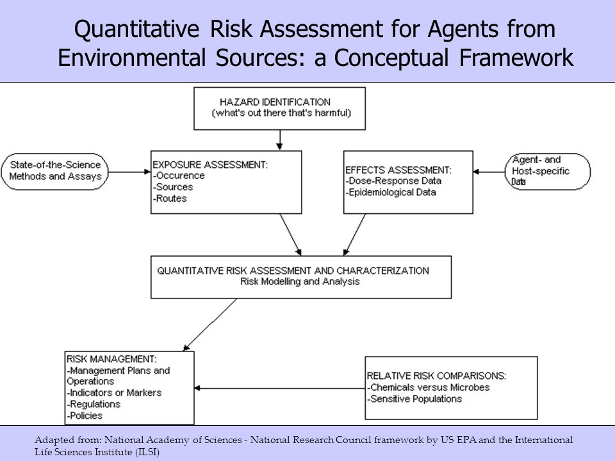
Quantitative Risk Assessment Framework

Slide 8
Risk Characterization
Single exposure
  Trauma, acute toxicity (poisoning)
Dose dependent
  Noise, vibration, chronic toxicity
Other outcomes
  Cancer
  Sensitization

Slide 9
Hierarchy of Evidence
Human studies (Epidemiology)
  same compound and same exposure or industry
  same compound and similar exposure or industry
  similar compounds and same/similar exposure or industry
Animal and in vitro studies (Experimental Toxicology)
In silico (Structure Function Relationships) (Computational Toxicology)

Slide 10
Animal Studies
Acute toxicity studies
  LD50: how much does it take to kill half of all the animals?
  LOEL: Lowest Observable Effect Level
  NOEL: No Observable Effect
Chronic toxicity studies:
  Best method but very expensive and time-consuming
  Proper design (route, dose, sacrifice times, animal selection) a must.
Safety Factors
Latency

Slide 11
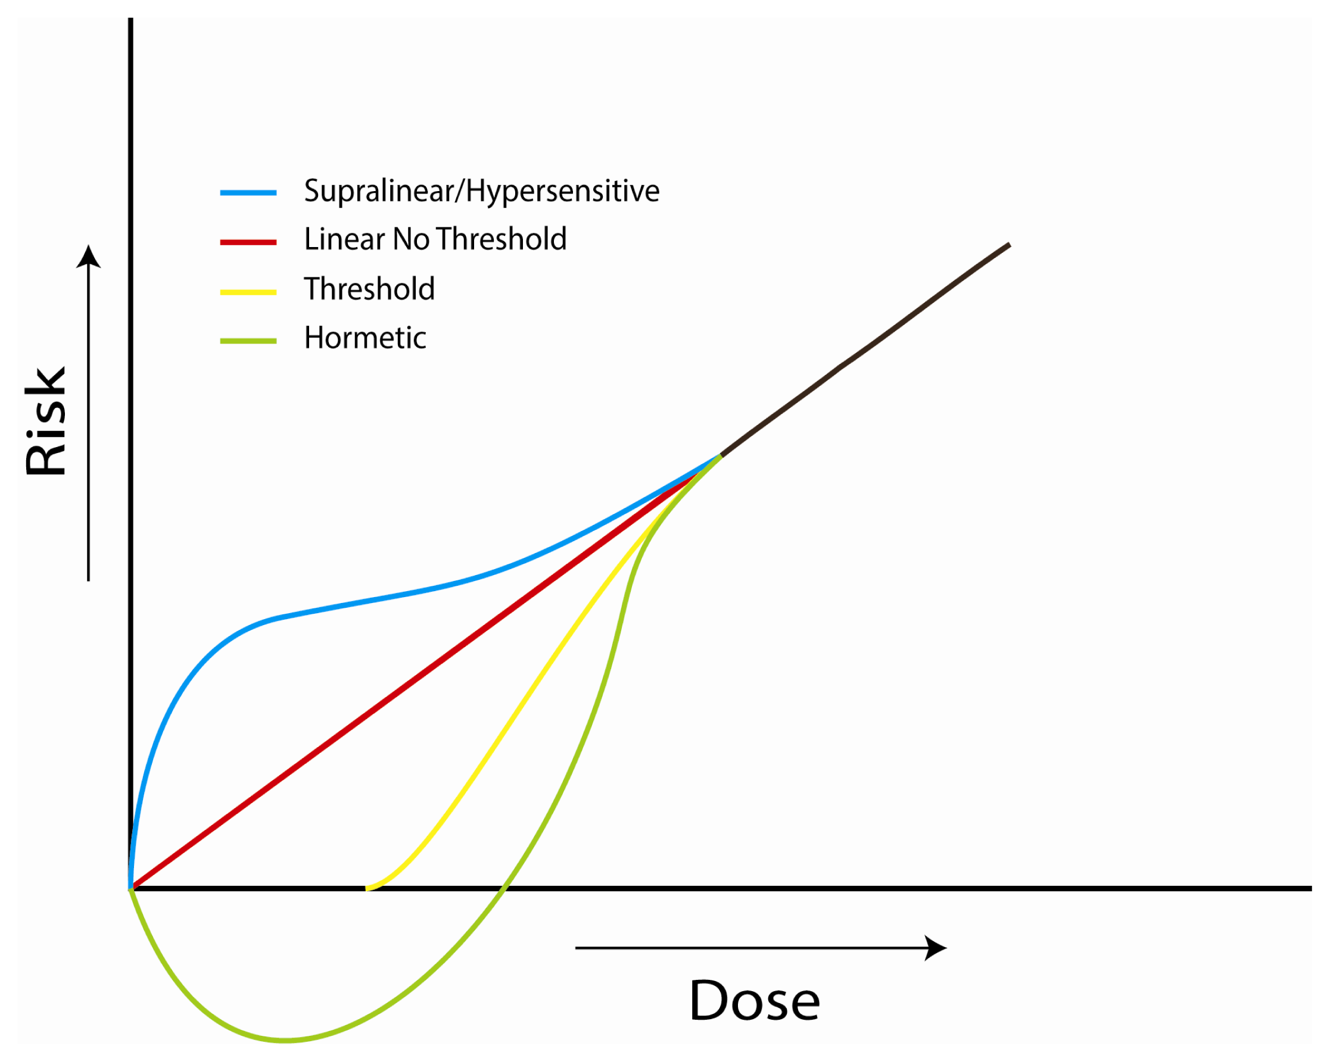
Assumptions
Linear Dose-Response
Vs.
Threshold Effect?
Hormetic Effect?
Hypersensitive Effect?

Slide 12
Risk Assessment Process
1. Hazard Identification
2. Hazard Evaluation or Dose-Response Assessment
3. Exposure Assessment
4. Risk Characterization

Slide 13
Hazard Identification and Dose-Response Assessment
Chemical structure
Physical properties
  density, melting point, vapor pressure, particle size
Toxicology Studies
Epidemiological studies

Slide 14
Hazard Identification Resources
ATSDR https://www.atsdr.cdc.gov/
  Tox profiles https://www.atsdr.cdc.gov/toxprofiles/index.asp
U.S. National Library of Medicine
  TOXNET https://toxnet.nlm.nih.gov/
  IRIS https://toxnet.nlm.nih.gov/newtoxnet/iris.htm
U.S. NIOSH
  NIOSH Pocket Guide https://www.cdc.gov/niosh/npg/default.html
  Mobile Edition https://www.cdc.gov/niosh/npg/mobilepocketguide.html

Slide 15
Information should answer these questions:
Does exposure to the substance produce any adverse effects?
If yes, what are the circumstances (route, dose) associated with the exposure?
  Route
  Duration
  Frequency
Other Factors which may affect results
  Diet
  Lifestyle choices
  Occupation

Slide 16
Exposure Assessment and Risk Characterization
Exposure means contact at a boundary between a human and the environment at a specific contaminant for a specified period of time.
Identifies affected population
Calculates the amount, frequency, length of time, and route of exposure

Slide 17
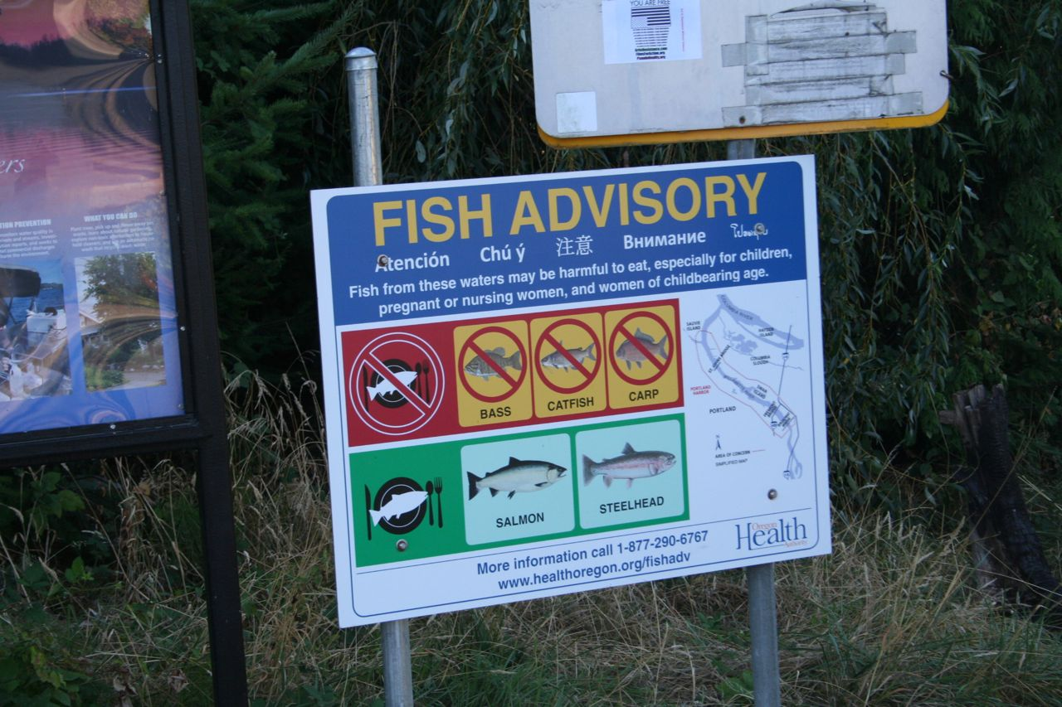
Environmental Exposure Assessment
Sources
Exposure Pathways and Environmental Fate
  How it is transported
  How it is accumulated in the environment and in tissue
  How it is transformed when it is released
Measured or Estimated Concentrations
  Measured concentrations are obtained from actual samples of the source of exposure
  Estimated concentrations are used when samples are not available, and are based on a mathematical model

Slide 18
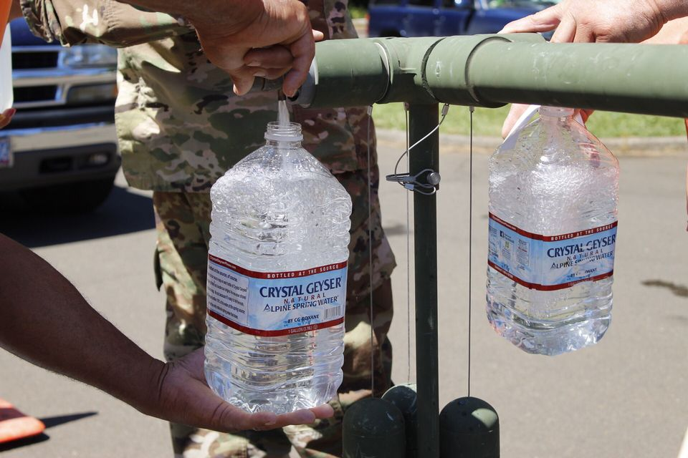
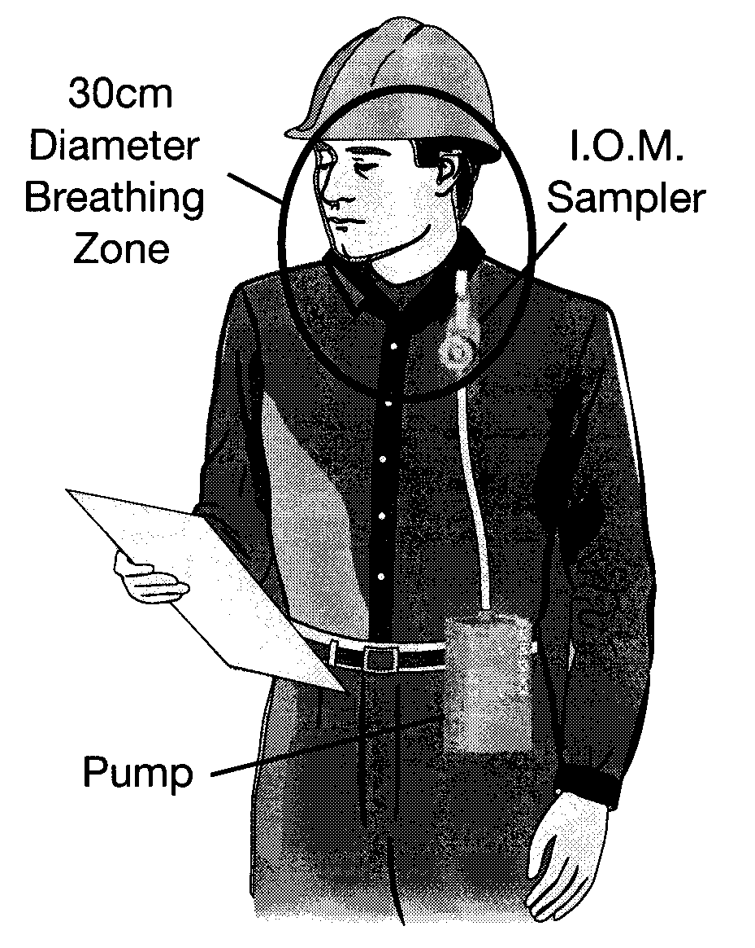
Individual Exposure Assessment
Indirect Methods
  Questionnaires/surveys
  Employment records
  Evaluation of environmental contamination data (food, water, air)
Direct Methods
  Personal workplace monitoring
  Biologic markers

Slide 19

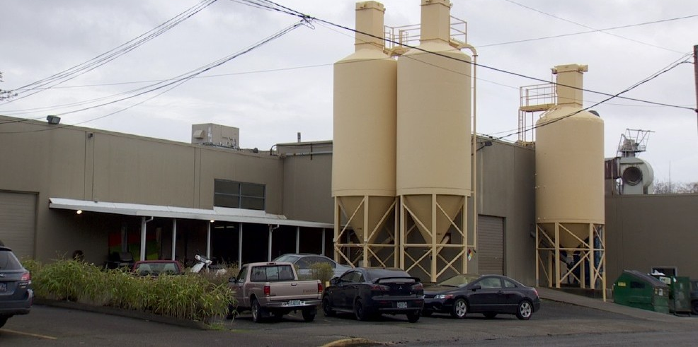


Community Approaches for Assessing Exposure
Environmental monitoring
Resident questionnaires/surveys
Fate and transport (migration) computer models

Slide 20
Resources
U.S. National Academies of Science, Engineering and Medicine
  National Research Council. 2012. Exposure Science in the 21st Century: A Vision and a Strategy. Washington, DC: The National Academies Press. https://doi.org/10.17226/13507.
U.S. Environmental Protection Agency
  EPOBOX https://www.epa.gov/expobox
  Risk Assessment Training and Experience (RATE) https://www.epa.gov/expobox/exposure-assessment-tutorials
U.S. NIOSH
  NIOSH Manual of Analytical Methods (NMAM) 5th Edition https://www.cdc.gov/niosh/nmam/

Slide 21
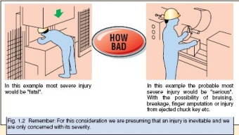

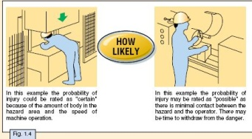
Risk Assessment Simplified
Notes:
There are many different styles of doing Risk Assessment.
Almost all of them start by asking three key questions:
How Bad?
How Often?
How Likely?
The answers to these three questions are combined to give a rating of where safety issues stand in relationship to each other.
We will examine these three questions first, and then look at other possible factors that should be considered.

Slide 22
Designing Surveillance Programs
Identify potential health outcomes
Identify appropriate screening tests
Identify appropriate frequency
Identify appropriate response and follow up

Slide 23
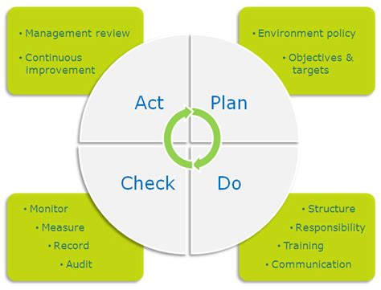
Risk Assessment in Occupational Health
Identify hazards and population at risk
Estimate or quantify risk and prioritize interventions
Design preventive strategy
  Elimination
  Substitution
  Isolation
  Work practices
  PPE
Implement and monitor outcomes (PDCA)

